Slide 1
Machine learning to unveil the fluid structure interaction of air-backed impact
Dynamical Systems Laboratory
New York University Tandon School of Engineering, Brooklyn, NY
Simon Carrillo Segura | Akhilesh Kapse
16 July 2021

Slide 2
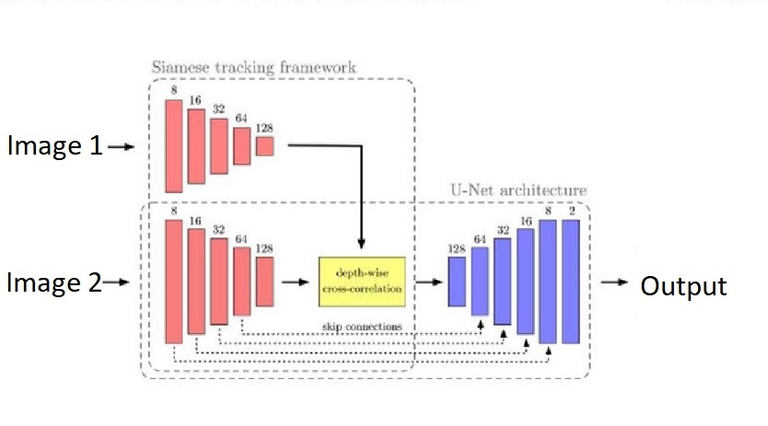
Working with new idea
For more improvement in model performance, we
are trying out the sequential data for training the model.
Giving 2/3 consecutive timestep images to model for predictions.

Slide 3
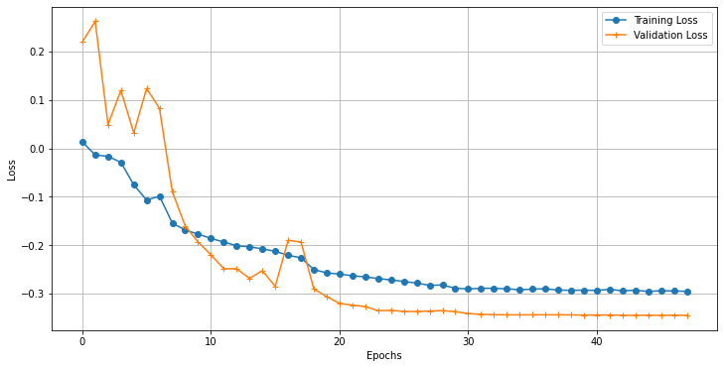
Model with 2 Image-Input
Input-
Image 1 ( t-timestep )
Image 2 ( (t+1)-timestep )
Output-
Velocity Components for Image 1
Loss- MSE + Cosine Similarity

Slide 4
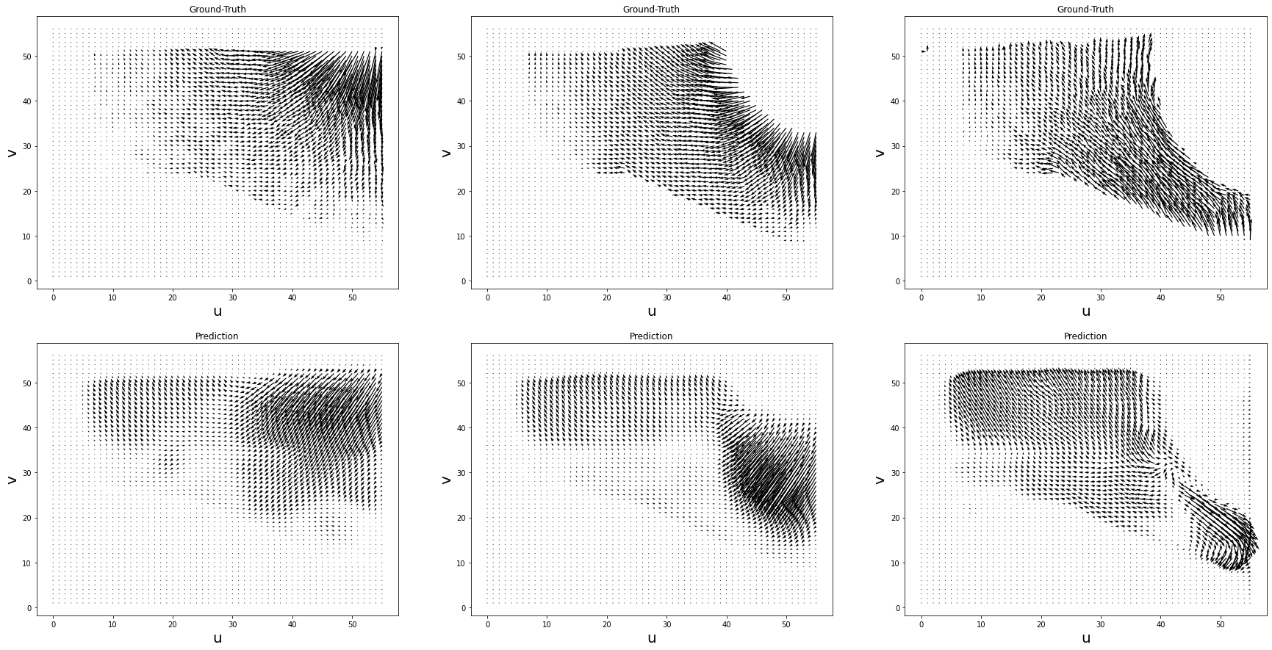
Results

Slide 5
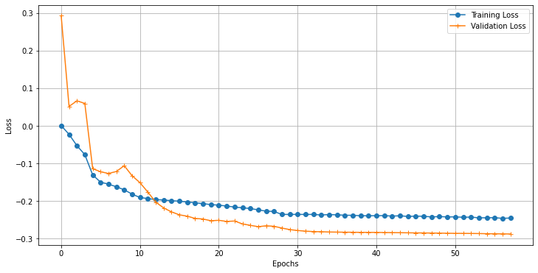
Model with 3 Image-Input
Input-
Image 0 ( (t-1) -timestep )
Image 1 ( t -timestep )
Image 2 ( (t+1) -timestep )
Output-
Velocity Components for Image 1
Loss- MSE + Cosine Similarity

Slide 6
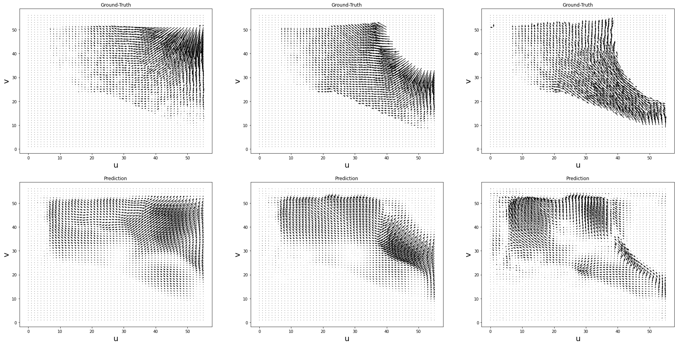
Results

Slide 7
Time Analysis - Masking Model
Model Info-
Unet model ( 20 batch size)
Total params: 34,536,897
Trainable params: 34,525,121 Non-trainable params: 11,776
Impactor Type | Spherical (447 images) | Cylindrical (401 images) | Plate-3cm (1000 images)
CPU | 347.9 sec | 316.2 sec | 788.2 sec
GPU (Tesla P100) | 12.9 sec | 4.5 sec | 10.5 sec

Slide 8
Time Analysis - Velocity Field Model
Model Info-
Saim-Unet model ( 20 batch size)
Total params: 56,465,411
Trainable params: 21,917,762 Non-trainable params: 34,547,649
Impactor Type | Spherical (447 images) | Cylindrical (401 images) | Plate-3cm (1000 images)
CPU | 942.6 sec | 867.8 sec | 2206 sec
GPU (Tesla P100) | 21.8 sec | 10.4 sec | 28.6 sec

Slide 9
Future work
Addition of pressure ground truth data from model.
Thank You

